Slide 1
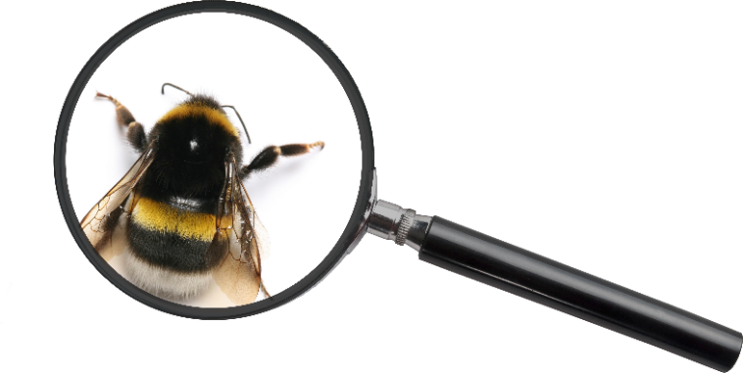
THIS IS TO CERTIFY THAT
Took part in Outdoor Classroom Day
on 12 October 2017
to celebrate outdoor learning and play!
Nick Gardner | Co-Founder and CEO | Project Dirt

